Slide 1


IELTS Listening Overview | How the Listening Test Really Works
Notes:
“Hello, my name is April Ampong, and I’m an instructor at IELTS NINER REVIEW CENTER— an international-standard IELTS training system that helps learners progress from beginner level to Band 7.0–9.0 in the most time-efficient way.”
“IELTS Listening is often seen as the easiest part of the test— but it’s also the section where many candidates lose easy points.”
“This usually doesn’t happen because of poor English.” “It happens because candidates don’t fully understand the test structure or they listen in the wrong way.”
“In this video, I’ll show you how the IELTS Listening test is structured, what it really tests, and how to approach it the right way from the beginning.”

Slide 2
Listening Test Format
IELTS Listening lasts 30 minutes, with 40 questions in total.
If you take the paper-based test, you have 10 extra minutes at the end to transfer your answers.
You will hear each recording only once, so concentration is critical.
Notes:
“In the previous video, we covered the IELTS test format and timing.”
“Now we’ll focus on the first skill tested on exam day—Listening.”
“IELTS Listening lasts 30 minutes, with 40 questions in total.”
“If you take the paper-based test, you get 10 extra minutes at the end to transfer your answers to the answer sheet.”
In the computer based test “There are no extra 10 minutes at the end.”
“Instead, you get 2 minutes to check your answers after each section.”
“This means you must type your answers while listening, not later.
But remember this— you will hear each recording only once.”
“That means there are no second chances.” “If your concentration drops, even for a moment, you can lose an answer.”
“This is why IELTS Listening is not about hearing everything.” “It’s about staying focused, following the questions, and listening for the exact information you need.”
“If you fall behind or panic, you don’t just miss one answer— you can miss several.”

Slide 3
The Four Sections of IELTS Listening
The Listening test has four sections, and they become progressively more difficult.
Section 1: A conversation in a social context, such as booking a service.
Section 2: A monologue in a social context, often giving information or directions.
Section 3: A conversation in an academic context, usually among students.
Section 4: An academic lecture or talk.
NOTE!!! As the sections progress, the language becomes faster, more complex, and more academic.
Notes:
“The Listening test has four sections, and they become progressively more difficult.”
“Section 1 is a conversation in a social context, such as booking a service or making an enquiry.”
“Section 2 is a monologue in a social context, often giving information, instructions, or directions.”
“Section 3 is a conversation in an academic context, usually between students discussing an assignment.”
“Section 4 is an academic lecture or talk, similar to what you would hear at university.”
“By the time you reach Section 4, the language is faster, more complex, and there are fewer pauses.”
“That’s why strong focus from the beginning is essential— every section counts the same.”

Slide 4
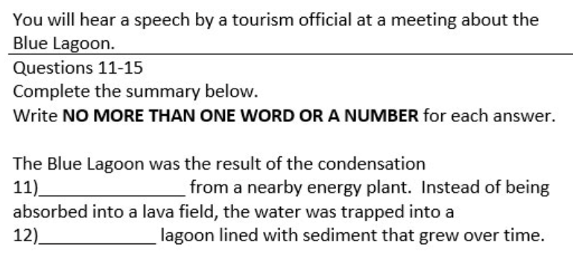
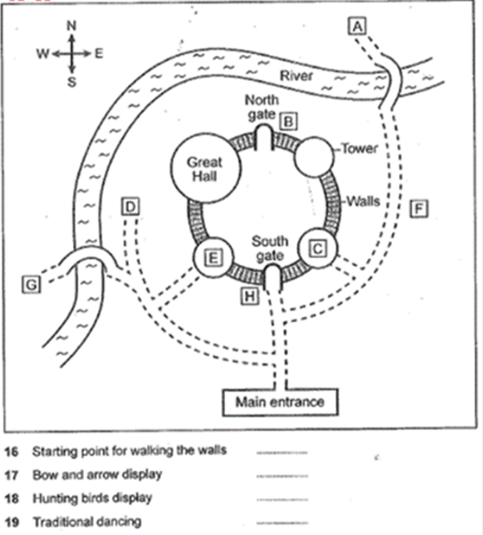
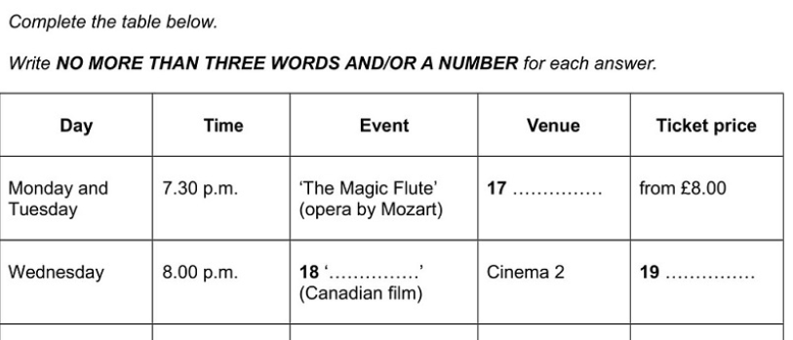
Common Question Types
The most common ones
Multiple choice
Form, note, or table completion
Sentence completion
Matching
Map or diagram labelling
Each question type tests listening accuracy, not memory.
Notes:
“The most common question types you’ll see are: multiple choice, form, note, or table completion, sentence completion, matching, and map or diagram labelling.”
“Each of these question types tests listening accuracy, not memory.”
“You are not expected to remember long conversations.” “You are expected to identify key words, follow information in order, and write exactly what you hear.”
“This is why spelling, number formats, and word limits matter.”
“If you focus on accuracy instead of speed, your Listening score becomes much more predictable.”

Slide 5
What IELTS Listening Really Tests
IELTS Listening does not test how much English you know.
It tests:
Your ability to follow information in real time
Your understanding of paraphrasing
Your attention to detail—especially spelling and numbers
Most mistakes happen because candidates listen for keywords, not meaning.
Notes:
“IELTS Listening does not test how much English you know.”
“It tests three key skills.”
“First, your ability to follow information in real time— without pausing or replaying.”
“Second, your understanding of paraphrasing— because the words you hear are often different from the words in the question.”
“And third, your attention to detail— especially spelling, numbers, dates, and plurals.”
“Most listening mistakes happen for one reason.” “Candidates listen for keywords, instead of listening for meaning.”
“That’s why they hear the word— but still choose the wrong answer.”
“When you change how you listen, your score changes too.”
“Now that you understand how the Listening test works, the next step is learning how to prepare before the audio starts.”
“In the next video, we’ll focus on: 👉 Predicting answers before listening—the most powerful Listening strategy.”
“See you in the next video.”

